Slide 1


202304深圳二模
阅读-语填+二次开发
英语教学教研工作坊 编制

Slide 2
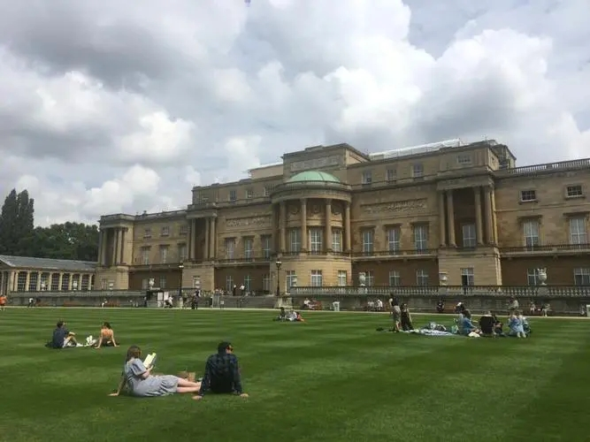
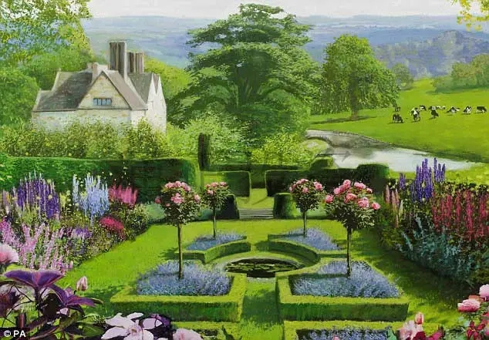
Passage A
语篇类型：应用文
主题语境：人与社会
介绍伦敦的四个花园

Slide 3

Horniman Gardens
Horniman GardensHorniman Gardens cover 16 acres with breathtaking views of London. Visitors can enjoy the Sound Garden, Meadow Field, and even a Prehistoric Garden, which features a display of“living fossils”. The gardens are very popular with families, and dogs can be let off their leads in the Meadow Field.
放开他们的缰绳疯跑
Chiswick Garden
As a classical garden landscape in London, it was here that the English Landscape Movement was born with William Kent's designs. Enjoy fresh bread, seasonal food, and natural wines in the award-winning cafe, while admiring the beauty of the naturalistic landscape, spotted with impressive art and statues.
21. What can visitors do in both Hormiman Gardens and Chiswick Garden?
Study living fossils. B. Taste delicious food.
C.Enjoy impressive art. D.Appreciate fine views.
(细节理解题)

Slide 4
Kew Garden
The Royal Botanic Garden at Kew is one of the world's most famous gardens and a UNESCO World Heritage Site. Have a walk through the vast garden, spot local wildlife at the lake, or get your hands dirty by trying a gardening lesson. Be sure to visit the Temperate House, which contains some of the rarest and most threatened plants.
亲历亲为;自己动手
同义词转换：get one’s hands dirty=hands-on
(细节理解题)
22. Where should visitors go if they want to join in hands-on activities?
A.Horniman Gardens. B.Chiswick Garden.
C.Buckingham Palace. D. Kew Garden.

Slide 5
Even in the big city you can find oases (绿洲) of calm and beauty. From a royal palace to aclassical garden, we recommend great green spaces to escape the hustle and bustle of London.
词汇积累：the hustle and bustle of... 忙碌喧嚣
(写作目的题)
23.What is the purpose of the text?
A. To inform visitors of famous gardens.
B. To entertain interested garden visitors.
C. To stress the necessity of garden escape
D. To show the benefits of touring gardens

Slide 6
重要词汇
oasis (pl:oases)
the hustle and bustle
breathtaking
feature
seasonal
be spotted with
cream tea
1. 绿洲
2. 忙碌喧嚣
3. 令人窒息的
4. v. 以...为特点
5. adj. 季节的
6. 布满；充满
7. （下午进用的）奶油茶点
词义辨析：seasonal vs seasoned
e.g. a seasoned teacher/performer/traveller=experienced
a seasoned soup=spiced

Slide 7
长难句分析
祈使句+三个并列宾语
Enjoy fresh bread, seasonal food, and natural wines in the award-winning cafe, while admiring the beauty of the naturalistic landscape, spotted with impressive art and statues.
while引导时间状语从句
conj后的省略句
过去分词短语作后置定语，修饰landscape
主干： Enjoy fresh bread, seasonal food, and natural wines
翻译：在那个享受盛名的咖啡馆，尽情享受这些新鲜面包，季节性食物，天然的酒，与此同时欣赏这些绝美的，点缀着美丽艺术和雕像的自然主义的风景。

Slide 8
语法填空
oases
Even in the big city you can find _______ (oasis) of calm and beauty.
The gardens are very popular with families, and dogs can _______ (let)off their leads in the Meadow Field.
_______ (enjoy) fresh bread, seasonal food, and natural wines in the award-winning cafe, while ____________(admire) the beauty of the naturalistic landscape, _______ (spot)with impressive art and statues.
A tour of the garden can be completed by having a cream tea in the cafe ______________ (overlook) the Palace’famous grassland and lake.
be let
Enjoy
admiring
spotted
overlooking

Slide 9
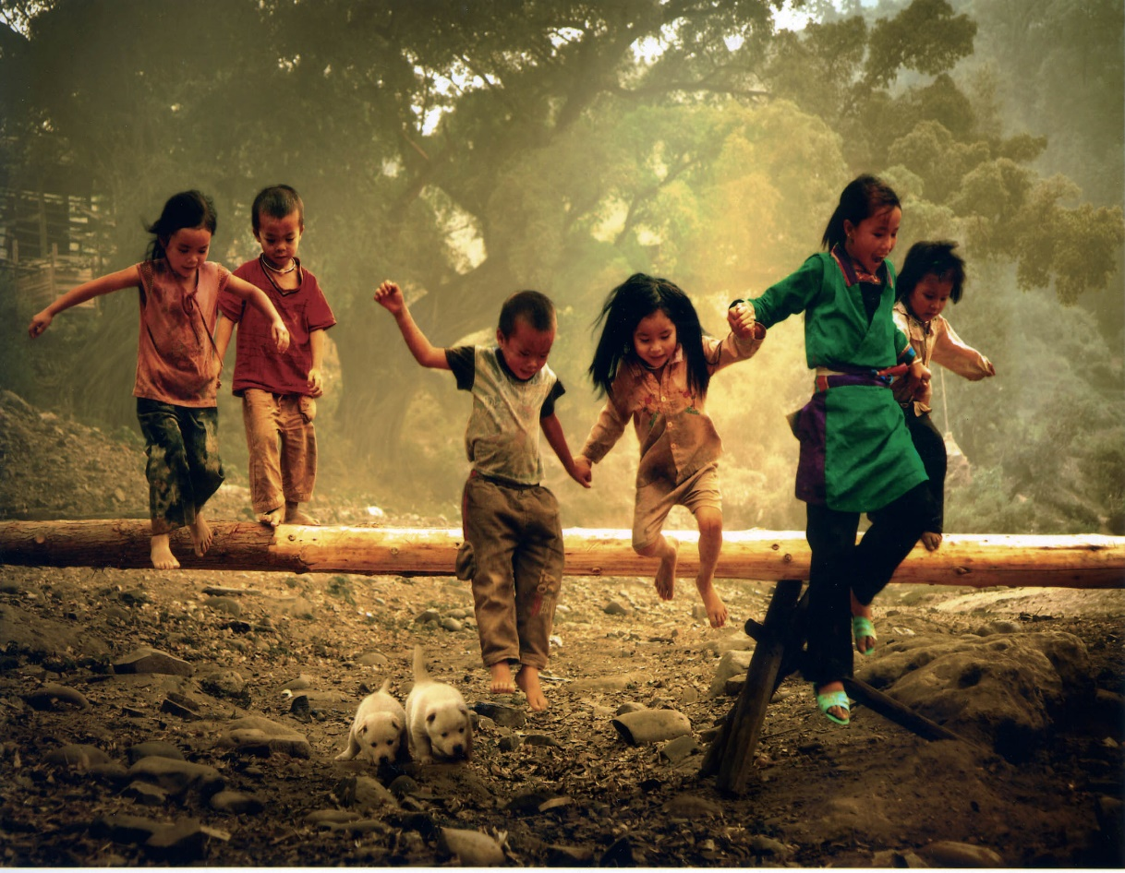
Passage B
语篇类型：记叙文
主题语境：人与自我
讲述作者的童年回忆

Slide 10
My childhood was a painted picture of sunny sky and rolling green fields stretching to the horizon. It tasted of sharp berries and smelt of sour grapes. My family lived in a cabin (小大屋)in the countryside but I lived in my mother's arms. They were so delicate but strong, her red hair falling around me like a curtain separating me from the world.
Childhood was simple. The borders of my village were the furthest my troubles went and monsters only lived in the pages of books. Every day was a waking dream of running races and muddy knees. My village was archaic, dying cabins housing dying farmers with dying traditions.There weren't many children but me and the other boys; boys of butchers and sellers formed our own group.
They called us wild. I suppose we were. Trees and mountains formed our playgrounds and fights broke out as easily as sudden laughter. Liberated from the restrictions of society, we would bound into the woods, deeper and deeper until we found a lake which, with a wild yell, we would jump into all at once.
My most vivid memories from boyhood center around that lake. Water shone brightly and the sounds of our screams broke into the outcry from birds, The shock of cold water against sweating skin would wake every nerve in my body and my bare feet would hit the sinking muddy bottom. As we submerged (淹没), time would suspend, movements slowing as bubbles rose around us.
I was drowning. I was living. I was living. I was drowning.
For timelessness or a second (both felt the same), we would suspend, curl up, and then be forced back out into breathing air.
We should have known that it wouldn't last forever. Yet, even under the best circumstances there's something so tragic about growing up: to have your perspective on the people and lifearound you change; to always struggle to reach a mirror only to find yourself tall enough to see your reflection one day. And find, a different person staring back out at you.
P1: 童年给我的整体回忆感受。
P2: 童年的我住在一个过时的老村庄，小伙伴们也都很疯狂。
P3: 我们会在森林里疯狂的玩耍。
P4-6: 我对童年最清晰的回忆是那条湖。
P7: 那种自由的感觉不会持久，因为最终我们都会长大，成为一个完全不同的人。

Slide 11
Childhood was simple. The borders of my village were the furthest my troubles went and monsters only lived in the pages of books. Every day was a waking dream of running races and muddy knees. My village was archaic, dying cabins housing dying farmers with dying traditions.There weren't many children but me and the other boys; boys of butchers and sellers formed our own group.
同义词转换：dying farmers with dying traditions
=old-fashioned
24. What does the underlined word “archaic” mean in paragraph 2?
Borderless. B.Valueless.
C.Old-fashioned. D.Poverty-stricken.
(词义猜测题)
无边界的
赤贫的；一贫如洗的

Slide 12
They called us wild. I suppose we were. Trees and mountains formed our playgrounds and fights broke out as easily as sudden laughter. Liberated from the restrictions of society, we would bound into the woods, deeper and deeper until we found a lake which, with a wild yell, we would jump into all at once.
从...中挣脱出来
突然扎进
一系列的动作描述可以看出，他们在森林里玩的很疯。
25. Why did the author consider himself and other children wild?
A.They played in the woods crazily.
B. They tricked others purposefully.
C. They frequently broke social rules.
D. They firmly refused school education.
(推理判断题)
=deliberately 故意地

Slide 13
My most vivid memories from boyhood center around that lake. Water shone brightly and the sounds of our screams broke into the outcry from birds, The shock of cold water against sweating skin would wake every nerve in my body and my bare feet would hit the sinking muddy bottom. As we submerged (淹没), time would suspend, movements slowing as bubbles rose around us.
I was drowning. I was living. I was living. I was drowning.
For timelessness or a second (both felt the same), we would suspend, curl up, and then be forced back out into breathing air.
可知作者从自己当时的所见、所听、所感等多个层面描绘了自己童年时对于湖的回忆。
26. How does the author introduce his memories of the lake?
A. By sharing feelings. B. By expressing ideas.
C. By making comparisons. D. By describing characters.
(写作方式题)

Slide 14
We should have known that it wouldn't last forever. Yet, even under the best circumstances there's something so tragic about growing up: to have your perspective on the people and life around you change; to always struggle to reach a mirror only to find yourself tall enough to see your reflection one day. And find, a different person staring back out at you.
27. What message does the author seem to convey in the last paragraph?
Loneliness and challenges make a man grow up.
B. The regret of growth is that you have never tried.
C. Growth is often accompanied by sad goodbyes to the past.
D. Growth begins when we begin to accept our own weakness.
段落主旨题

Slide 15
重要词汇
liberated from
restriction
center around/on
suspend
timelessness
tragic
1.从...中挣脱出来
2. 限制
3. 围绕着
4. 暂停
5. 不朽
6. 悲剧的

Slide 16
长难句分析
as引导时间状语从句
独立主格结构作状语
1. As we submerged (淹没), time would suspend, movements slowing as bubbles rose around us.
主干： time would suspend
翻译：当我们潜入水中时，时间会停止，随着气泡在我们周围升起，运动变慢。

Slide 17
长难句分析
there be 句型
形容词修饰不定代词形容词后置
2. Yet, even under the best circumstances there's something so tragic about growing up: to have your perspective on the people and life around you change; to always struggle to reach a mirror only to find yourself tall enough to see your reflection one day.
have sb do
only to do 表示一种意想不到的结果
两个动词不定式为something的同位语
主干： there's something
翻译：然而，即使在最好的情况下，成长也有一些悲剧:你对周围人和生活的看法发生了变化;总是挣扎着够到镜子，直到有一天发现自己足够高，可以看到自己的倒影。

Slide 18
语法填空
My childhood was a painted picture of sunny sky and rolling green fields ____________ (stretch) to the horizon
They were so delicate but strong, her red hair _______ (fall) around me like a curtain separating me from the world.
Water _______ (shine) brightly and the sounds of our screams broke into the outcry from birds,
As we submerged (淹没), time would suspend, movements _______ (slow) as bubbles rose around us.
For _____________ (timeless) or a second (both felt the same), we would suspend, curl up, and then be forced back out into breathing air.
to have your perspective on the people and life around you _______ (change).
stretching
falling
shone
slowing
timelessness
change

Slide 19
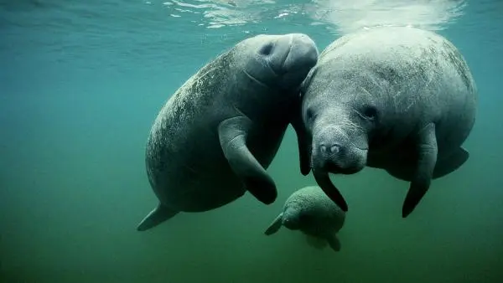
Passage C
语篇类型：议论文
主题语境：人与自然
介绍了sea cow物种的灭绝风险等级提升及其影响。

Slide 20
In shallow coastal waters of the Indian ocean,Dugong,a kind of sea cow, is in trouble. Environmental problems pose such a major threat to its survival that the International Union for Conservation of Nature(IUCN)upgraded the species’ extinction risk status(地位)to vulnerable(脆弱的).
Much worse, Dugongs are at risk of losing the protection of the Torres Strait Islanders, who have looked after them historically,hunting them for food sustainably and monitoring their numbers. These native people keep their biodiversity, and have deep knowledge about their environment, But these people are also threatened, in part because rising sea levels are making it difficult for them to live there.
This situation isn’t unique to Dugongs.A global analysis of 385 culturally important plant and animal species found 68 percent were both biologically vulnerable and at risk of losing their cultural protection.
The findings clearly illustrate that biology shouldn’t be the primary factor in shaping conservation policy, says anthropologist Victoria Reyes-Garcia. When a culture declines,the species that are important to that culture are also threatened.
“Lots of conservationists think we need to separate people from nature,”says Reyes-Garcia.“But that strategy misses the caring relationship many cultural groups have with nature.”
One way to help shift conservation efforts is to give species a “bio-cultural status,” which would provide a fuller picture of their vulnerability. In the study,the team used a new way to determine a species’ risk of disappearing: the more a cultural group’s language use declines,the more that culture is threatened.The more a culture is threatened the more culturally vulnerable its important species are. Researchers then combined a species’ cultural and biological vulnerability to arrive at its bio-cultural status. In the Dugong’s case, its bio-cultural status is endangered, meaning it is more at risk than its IUCN categorization suggests.
This new approach to conservation involves people that have historically cared for them.It can highlight when communities need support to continue their care. Scientists hope it will bring more efforts that recognize local communities’ rights and encourage their participation --taking advantage of humans’ connection with nature instead of creating more separation.
P1-P2: 环境变化及失去岛民保护使海牛面临灭绝风险
提出问题
P3-P4: 保护文化群体与保护生物密切相关
分析问题
解决问题
P5:给物种一种“生物文化地位”
P6: 科学家对新的解决方法的期待

Slide 21
28. What is the relationship between the native people and Dugongs?
A.The native people help conserve Dugongs.
B. The native people train Dugongs to survive
C. Dugongs ruin the native people’s environment.
D. Dugongs force the native people to leave home.
同义替换
These native people keep their biodiversity
≈ The native people help conserve Dugongs
Much worse, Dugongs are at risk of losing the protection of the Torres Strait Islanders, who have looked after them historically,hunting them for food sustainably and monitoring their numbers. These native people keep their biodiversity, and have deep knowledge about their environment, But these people are also threatened, in part because rising sea levels are making it difficult for them to live there.

Slide 22
29. Which statement will Reyes-Garcia probably agree with?
A. The protection policy is used incorrectly.
B.Culture is connected to species existence
C. Many groups take good care of each other.
D. Conservationists prefer nature over people.
同义替换the caring relationship...with nature≈is connected to.
The findings clearly illustrate that biology shouldn’t be the primary factor in shaping conservation policy, says anthropologist Victoria Reyes-Garcia. When a culture declines,the species that are important to that culture are also threatened. “Lots of conservationists think we need to separate people from nature,”says Reyes-Garcia.“But that strategy misses the caring relationship many cultural groups have with nature.”

Slide 23
30. How is the study method different from previous ones?
A. It involves more preservation efforts.
B. It relies on the IUCN’s classification.
C. It highlights the effect of human languages.
D. It assesses the biological influence of a species
分类
强调
同义替换 the more a cultural group’s language use declines, the more that culture is threatened...the more culturally vulnerable its important species are.
≈ It highlights the effect of human languages.
In the study, the team used a new way to determine a species’ risk of disappearing: the more a cultural group’s language use declines, the more that culture is threatened. The more a culture is threatened, the more culturally vulnerable its important species are. Researchers then combined a species’ cultural and biological vulnerability to arrive at its bio-cultural status.

Slide 24
31.What is the author’s attitude towards the latest approach?
Conservative.保守的 B. Favourable.赞成的
C. Critical 批判的 D. Ambiguous模棱两可的
同义替换
cared for，highlight，support，都是积极正面的词汇
This new approach to conservation involves people that have historically cared for them. It can highlight when communities need support to continue their care.

Slide 25
高频态度类词汇
一. 赞同
positive 肯定的, 实际的, 积极的, , 确实的
favorable 赞成的, 有利的, 赞许的, 良好的
approval 赞成, 承认, 正式批准
enthusiasm 狂热, 热心, 积极性
supportive 支持的，支援的
defensive 为……而辩护
二. 否定
negative 否定的, 消极的, 负的, 阴性的
disapproval 不赞成
objection 异议
opposition 反对
critical 批评的
criticism 批评批判
disgust 令人厌恶, 令人反感vt.使作呕
warning 警告的; 告诫的; 引以为戒的

Slide 26
三. 怀疑
sceptical 怀疑的
suspicion 猜疑, 怀疑
suspicious (～ of) 可疑的, 怀疑的
doubt 怀疑，疑惑
doubtful 可疑的, 不确的, 疑心的
question 疑问，怀疑
puzzling 使迷惑的, 使莫明其妙的

Slide 27
四. 客观
objective 客观的
neutral 中立的
unprejudiced 没有偏见的
unbiased 没有偏见的
detached 不含个人偏见的
五. 主观
subjective 主观的, 个人的
indifference 不关心
tolerance 宽容，容忍，忍受
pessimism 悲观, 悲观主义
gloomy 黑暗的, 阴沉的, 令人沮丧的, 阴郁的
optimistic 乐观的
reserved 保留的, 包租的

Slide 28
. 中立/折中
impartial 公平的, 不偏不倚的
neutral 中立的
impersonal 非个人的
factual 事实的, 实际的,根据事实的
detached 不含个人偏见的

Slide 29
重要词汇
conservation
status
vulnerable
sustainably
monitor
primary
categorization
approach
care for
taking advantage of
n.保护
n.地位
adj.脆弱的
adv.可持续性
v.监管 n.班长，显示器
adj.初始的
n. 分类
n.方法 v.靠近，接近
照顾
利用

Slide 30
长难句分析
hope后省略that引导的宾语从句
第一个that引导定语从句,修饰efforts
1. Scientists hope it will bring more efforts that recognize local communities’ rights and encourage their participation --taking advantage of humans’ connection with nature instead of creating more separation.
现在分词解释说明
句子主干： Scientists hope that …
句子翻译：科学家们希望它能带来更多的努力，承认当地社区的权利，鼓励他们的参与——利用人类与自然的联系，而不是制造更多的分离。

Slide 31
语法填空
Environmental problems pose such a major threat to its survival _______ the International Union for Conservation of Nature(IUCN) ____________ (upgrade) the species’ extinction risk status(地位) _______ to vulnerable(脆弱的).
In the Dugong’s case, its bio-cultural status is endangered, __________ （mean) it is _______ at risk than its IUCN categorization suggests.
Scientists hope it will bring more efforts that recognize local _______ (community) rights and encourage their participation --taking advantage of humans’ connection with nature instead of creating more ____________ (separate).
that
upgraded
to
meaning
more
communities’
separation

Slide 32
D
Adapting to technological advances is a defining part of the 21s-century life. Just two months after being launched in November 2022, OpenAl's ChatGPT has already reached an audience of over 100 million people. While ChatGPT threatens to change writing and writing-related work, the Mesopotamians, who lived 4,000 years ago in a geographical area centered in modern-day Iraq, went through this kind of far-reaching change before us.
Ancient Mesopotamia was home to many of civilization's early developments. Its people were world leaders in adapting to technological and cultural changes. They invented the wheel and agriculture, and pioneered advances in mathematics and urbanization. These breakthroughs are reflected in cuneiform （楔形文宇)literature, one of the oldest known forms of writing.
In its literature, Mesopotamians don't present cultural and technological advances as consistently beneficial. They often represent new technologies being controlled in the service of human conflict and mostly serving the interests of those with high social positions. In some ways, the representation of new technologies in its literature echoes (I Ill) contemporary concerns about AI: fears of increasing social inequalities and its potential use in information war.
In recent years, AI - the newest form of writing — has been used to decipher（破译）the oldest: cuneiform literature. In broader fields, the boundaries of how Al may be used haven't been clearly explained. In January, for example, a top international AI conference banned the use of AI tools for writing scientific papers.
Humans lave been struggling to invent, use and adapt to technology since our earliest civilizations. But the technology and resulting knowledge are not always evenly distributed. Knowing how we adapted to changing technology in the past helps us more fully understand the human condition and may even help us prepare for the future.
总： Adapting to technological advances is a defining part of the 21s-century life.
分： achievements in civilization.
分： cultural and technological advances bring about hidden dangers.
分： AI's range of application is undefined.
总：the impact of adapting to changing technology in the past

Slide 33
Ancient Mesopotamia was home to many of civilization’s early developments. Its people were world leaders in adapting to technological and cultural changes. They invented the wheel and agriculture, and pioneered advances in mathematics and urbanization. These breakthroughs are reflected in cuneiform (楔形文字) literature, one of the oldest known forms of writing.
32. What does paragraph 2 mainly talk about concerning Mesopotamians?
A. Their adaptation to threats.
B. Their influences on writing.
C. Their contribution to literature.
D. Their achievements in civilization.
段落大意→段落主旨句

Slide 34
In its literature, Mesopotamians don't present cultural and technological advances as consistently beneficial. They often represent new technologies being controlled in the service of human conflict and mostly serving the interests of those with high social positions. In some ways, the representation of new technologies in its literature echoes (映现) contemporary concerns about AI: fears of increasing social inequalities and its potential use in information war.
33. What can be inferred about technological advances from paragraph 3?
A. They prevent human conflict.
B. They bring about hidden dangers.
C. They take away people's concerns.
D. They lower people's social status.
推理判断→同义转换
身份；地位
同义替换：potential = hidden
social inequality + war = dangers

Slide 35
In recent years, AI - the newest form of writing — has been used to decipher（破 译）the oldest: cuneiform literature. In broader fields, the boundaries of how Al may be used haven't been clearly explained. In January, for example, a top international AI conference banned the use of AI tools for writing scientific papers.
34. What is the current situation of AI according to paragraph 4?
A. Its use in literature is popular.
B. It is not allowed to finish papers.
C. Its range of application is undefined.
D. It is not accepted in broader fields.
未阐明的
同义替换：
have not been clearly explained =undefined

Slide 36
总：Humans have been struggling to invent, use and adapt to technology since our earliest civilizations. But the technology and resulting knowledge are not always evenly distributed. Knowing how we adapted to changing technology in the past helps us more fully understand the human condition and may even help us prepare for the future.
35. Which of the following is a suitable title for the text?
A. How People Can Use the Latest Technology
B. How ChatGPT Will Threaten Writing and Work
C. What AI Will Do by Learning Cuneiform Literature
D. What History Can Teach Us About New Tech's Impact
文章标题→文章结构和内容

Slide 37
重要词汇
1. urbanization
2. consistently
3. contemporary
4. breakthrough
5. decipher
6. adapt to
7. echo
8. boundary
9. distribute
n. 城市化；都市化
adv. 一贯地；始终如一地
adj.属同时期的；同一时代的 n. 同代人；同辈人
n. 突破；重大进展
v. 破译；辨认
适应
v. 回想；回荡 n.回响；回声；共鸣
n. 边界；界限；分界线
v. 分配；分发；分销；分散

Slide 38
长难句分析
后置定语
1. They often represent new technologies being controlled in the service of human conflict and mostly serving the interests of those with high social positions.
状语
后置定语
主干：They often represent new technologies
翻译：它们往往代表着为人类冲突服务的被控制的新技术，主要是为那些社会地位高的人的利益服务的。

Slide 39
长难句分析
宾语从句
2. Knowing how we adapted to changing technology in the past helps us more fully understand the human condition and may even help us prepare for the future.
主干：Knowing helps us… and may even help us…
翻译：了解过去我们是如何适应不断变化的技术有助于我们更全面地了解人类的状况，甚至可能帮助我们为未来做好准备

Slide 40
语法填空
to
1. Ancient Mesopotamia was home______ many of civilization's early developments.
2. Its people were world leaders in___________(adapt) to technological and cultural changes.
3. These breakthroughs_____________( reflect) in cuneiform literature, one of the oldest known forms of writing.
4. Knowing how we adapted to changing technology in the past _______ (help)us more fully understand the human condition and may even help us prepare_____ the future.
adapting
are reflected
helps
for

Slide 41

七选五
语篇类型：说明文
主题语境：人与自然
本文介绍热岛效应在城市和 乡村产生的原因及改善措施。

Slide 42
通读全文，理解主题，寻找线索
Have you noticed how evenings cool off more in rural areas than they do in cities? Urban areas also tend to get hotter during the day than any nearby areas with lots of greenery. 36
It's mainly caused by the difference in materials that cover the ground in urban areas and the countryside. In the country, evaporation (蒸发) of water from soil and the leaves of plants helps to cool the air. 37 Having fewer plants, cities have less evaporation and are unable to cool down the temperature.
Dark colours are another problem. Dark objects absorb all wavelengths of light, making the temperature increase more noticeably. In contrast, white objects reflect all wavelengths of light energy. 38 Sadly, most parts of cities are covered by asphalt (沥青) steel, roofs and bricks which are often dark in colour.
39 As people drive cars, heat buildings, and run air conditioners, cities are generating waste heat and pouring it into the atmosphere directly. The waste heat adds to the solar energy trapped by the tall buildings.
But cities don't have to be so hot. Some cities have lightened their streets. This is done by covering black asphalt streets, parking lots, and dark roofs with a more reflective gray coating. 40
Having more green spaces also helps. Plants serve as a natural air conditioner. They catch heat, release vapour (燕/) into the air, and take away heat, contributing to cooler, fresher cities.
P1: 引出主题，说明什么是热岛效应。
P2: 分析产生这种现象的原因。
P3: 黑色及黑色物质对热岛效应的影响。
P4：分析城市产生更多热能的原因。
P5:减少城市热能效应的方法。
P6: 绿植对减少热量的作用。

Slide 43

.
Have you noticed how evenings cool off more in rural areas than they do in cities? Urban areas also tend to get hotter during the day than any nearby areas with lots of greenery. 36
A. Cities also produce more heat than suburban areas.
B. The higher the temperature, the shorter the wavelength.
C. This phenomenon is known as the urban heat-island effect.
D. So it will not be transformed into heat which makes the air hot.
E. Changes in building materials have a minimal effect on city temperatures.
F. Much of the soil in cities, by contrast, has been covered with roads and buildings.
G. These changes can decrease air temperatures dramatically, especially in summer.
段末句，考查段落结论句。本文是一篇介绍热岛效应的科普文。首段的行文逻辑为从现象到结论，从而引出热岛效应这一地理名词。故答案为C。

Slide 44
It's mainly caused by the difference in materials that cover the ground in urban areas and the countryside. In the country, evaporation (蒸发) of water from soil and the leaves of plants helps to cool the air. 37 Having fewer plants, cities have less evaporation and are unable to cool down the temperature.
.
A. Cities also produce more heat than suburban areas.
B. The higher the temperature, the shorter the wavelength.
C. This phenomenon is known as the urban heat-island effect.
D. So it will not be transformed into heat which makes the air hot.
E. Changes in building materials have a minimal effect on city temperatures.
F. Much of the soil in cities, by contrast, has been covered with roads and buildings.
G.These changes can decrease air temperatures dramatically, especially in summer.
段中句，考查转折性过渡句。F选项的“城市的土地被道路和建筑覆盖”与前一句“evaporation of water from soil and the leaves of plants helps to cool to air”形成转折关系。这两句回应第二段主题句“城市和乡村土地的覆盖材料不同”。故答案为F。

Slide 45
Dark colours are another problem. Dark objects absorb all wavelengths of light, making the temperature increase more noticeably. In contrast, white objects reflect all wavelengths of light energy. 38 Sadly, most parts of cities are covered by asphalt (沥青) steel, roofs and bricks which are often dark in colour.
.
A.Cities also produce more heat than suburban areas.
B.The higher the temperature, the shorter the wavelength.
C.This phenomenon is known as the urban heat-island effect.
D.So it will not be transformed into heat which makes the air hot.
E.Changes in building materials have a minimal effect on city temperatures.
F. Much of the soil in cities, by contrast, has been covered with roads and buildings.
G.These changes can decrease air temperatures dramatically, especially in summer.
段中句，考查结论性过渡句。空前句子“In contrast, white objects reflect all wavelengths of light energy”和D选项形成因果关系。即，白色物品会反射所有波长的光，因此能量不会被转换成热量，从而让空气变热。故答案为 D。

Slide 46
.
39 As people drive cars, heat buildings, and run air conditioners, cities are generating waste heat and pouring it into the atmosphere directly. The waste heat adds to the solar energy trapped by the tall buildings.
A.Cities also produce more heat than suburban areas.
B.The higher the temperature, the shorter the wavelength.
C.This phenomenon is known as the urban heat-island effect.
D.So it will not be transformed into heat which makes the air hot.
E.Changes in building materials have a minimal effect on city temperatures.
F. Much of the soil in cities, by contrast, has been covered with roads and buildings.
G.These changes can decrease air temperatures dramatically, especially in summer.
段首句，考查段落主题句。A选项中的“produce more heat”与选项下一句的“generate waste heat”形成对应关系。开车，供暖或是开空调都是产生热量的行为。故答案为A。

Slide 47
But cities don't have to be so hot. Some cities have lightened their streets. This is done by covering black asphalt streets, parking lots, and dark roofs with a more reflective gray coating. 40
.
A.Cities also produce more heat than suburban areas.
B.The higher the temperature, the shorter the wavelength.
C.This phenomenon is known as the urban heat-island effect.
D.So it will not be transformed into heat which makes the air hot.
E.Changes in building materials have a minimal effect on city temperatures.
F. Much of the soil in cities, by contrast, has been covered with roads and buildings.
G.These changes can decrease air temperatures dramatically, especially in summer.
段末句，考查递进逻辑关系。本段的讨论内容为解决热岛效应的方法。G选项中的“these changes”对应了选项前面一句的方法，即，“covering black asphalt streets, parking lots, and dark roofs with a more reflective gray coating”。同时，G选项进一步解释了这些举措所能带来的好处，与前文形成递进关系。故答案为G。

Slide 48
重要词汇
1.rural areas
2. tend to do
3. greenery
4. evaporation
5. noticeably
6. in/by contrast
7. wavelength
8. atmosphere
9. generate
10. release
11. vapour
12. contribute to
1.乡村地区
2.倾向于
3.绿色植物
4.蒸发
5.显著的，明显的
6.相反
7.波长
8.气氛
9. 产生
10.释放，发行
11.蒸汽
12.有助于；促成

Slide 49
长难句分析
1. Sadly, most parts of cities are covered by asphalt (沥青) steel, roofs and bricks which are often dark in colour.
which引导的定语从句，修饰前面的asphalt (沥青) steel, roofs and bricks
主干： most parts of cities are covered by asphalt (沥青) steel, roofs and bricks
翻译：令人难过的是城市的大部分都被沥青，钢铁，房顶和砖块所覆盖，而这些东西都是黑色的。

Slide 50
语法填空
than
1. Have you noticed how evenings cool off more in rural areas ________ they do in cities?
2. It's mainly caused by the difference in materials _________cover the ground in urban areas and the countryside.
3. Dark objects absorb all wavelengths of light, __________(make) the temperature increase more noticeably.
4. _________(sad), most parts of cities are covered by asphalt (沥青) steel, roofs and bricks ___________ are often dark in colour.
5. The waste heat adds to the solar energy _____________(trap) by the tall buildings.
6. They catch heat, release vapour into the air, and take away heat, ___________(contribute) to cooler, fresher cities.
that
making
Sadly
which
trapped
contributing

Slide 51
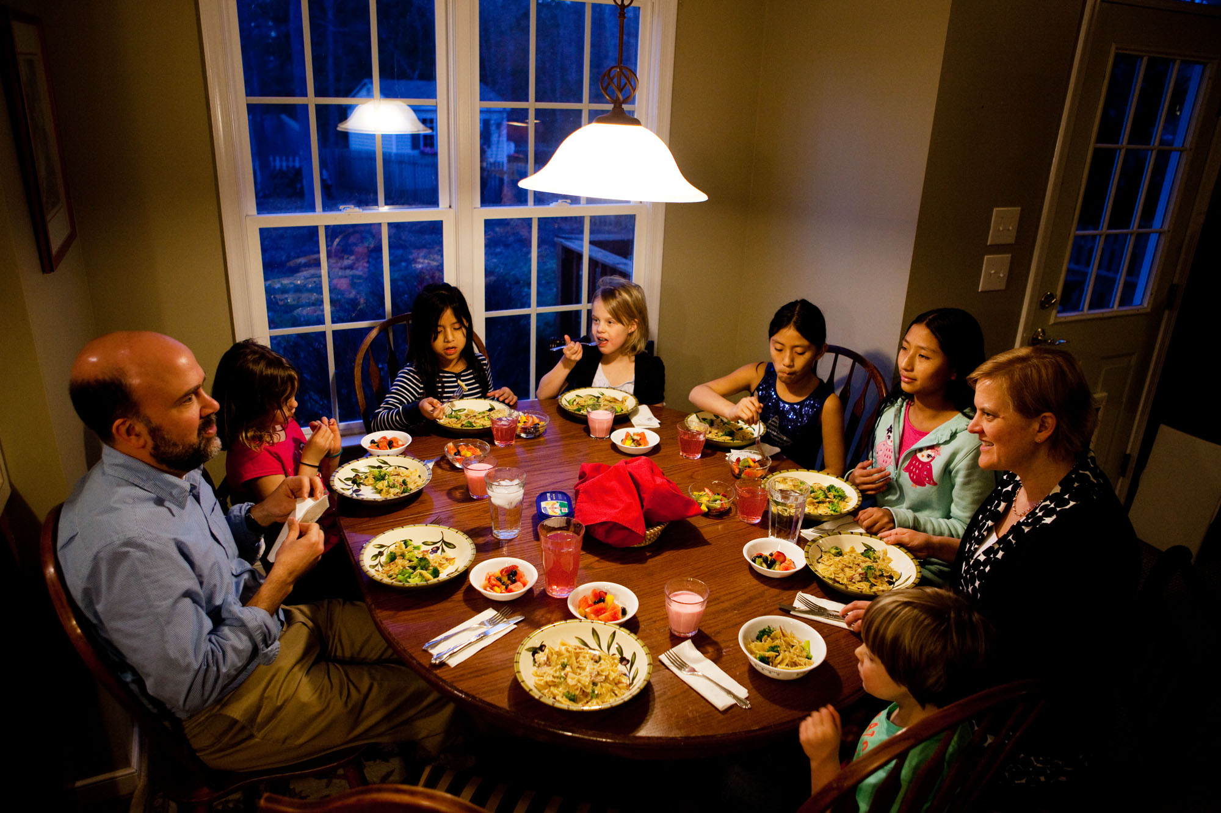
完形填空
语篇类型：记叙文
主题语境：珍惜和家人共处的时光

Slide 52
Growing up, I was fortunate to have dinner with my family almost every day. Sometimes, the family dinner circle ___41____ to include relatives stopping by. Yet, I knew some friends whose parents got home after dinner or even __42__the entire evening. So I __43__ the quality time around our kitchen table, which witnessed countless valuable ___44___ in my life.
__45_, my kids cannot relate to my childhood memories.They have been left to 46 with baby sitters more times than I would like to admit. My husband and I have 47careers. And we often end up staying at the office way past dinnertime. When this happens to often, it 48 the balance of our family.
Apart from suffering from 49 , what else can a hardworking family do? I think we can all try to 50 our own ways to spend time together, Surely there are days when I’m too busy to share a meal with my family. But I would make efforts to 51 and chat later that day, 52 setting aside cellphones every time. And I even find a bedtime reading with my kids much 53 . I am also proud to have our “big breakfast” routine every Saturday. My husband serves as the head chef, and my younger son 54 him to make the breakfast.
I am aware that my sons are growing up quickly and will be out of the 55 someday.But now, I am happy to have so many wonderful things on my plate.
P1故事开端：回忆和家人共进晚餐的美好时光
主旨：
珍惜和家人共处的时光
P2故事发展：因为忙碌的工作与家人共度晚餐的时间变少了。
P3故事高潮：作者还是想方设法地与家人相处，例如聊天、阅读或者周六共进早餐，这让她感到很幸福。
P4: 作者知道孩子们会在未来长大离开家庭，但是现在她很珍惜每一次跟家人团聚的机会。

Slide 53
瞻前顾后，不会往后看
Growing up, I was fortunate to have dinner with my family almost every day. Sometimes, the family dinner circle ___41____ to include relatives stopping by. Yet, I knew some friends whose parents got home after dinner or even __42__the entire evening.
41. | A.widened | B.formed | C.lessened | D.closed
v. | 扩大 | 形成 | 减少 | 关闭
42. | A.missed | B.avoided | C.enjoyed | D.recorded
v. | 错过 | 避免 | 享受 | 记录
41.根据后文to include relatives stopping by可知，家里的餐桌会扩大，以容纳这些来访的亲戚。故选widened
42. parents got home after dinner or even...可知，此处和前文形成递进关系 故选 missed

Slide 54
So I __43__ the quality time around our kitchen table, which witnessed countless valuable ___44___ in my life.
__45_, my kids cannot relate to my childhood memories.
瞻前顾后，不会往后看
43. | A. wasted | B.treasured | C.limited | D.calculated
v. | 浪费 | 珍惜 | 限制 | 计算
44. | A. shows | B.dishes | C.recipes | D.moments
n. | 展会 | 餐具；一盘食物 | 食谱;方法;秘诀 | 时刻
45. | A.However | B.Otherwise | C. Therefore | D.Besides
adv. | 然而 | 否则，要不然 | 因此 | 除...之外
43.空格后which witnessed countless valuable 因此，作者十分珍惜餐桌旁的亲子时光。故选treasured
44.根据quality time，childhood moments以及可知, 餐桌旁见证了我人生中无数珍贵的瞬间 故选moments
45.作者小时候可以和父母共进晚餐，但是作者的孩子只能和保姆一起吃晚餐。因此形成转折关系,他们并不能对我童年的回忆感同身受”。故选However

Slide 55
They have been left to 46 with baby sitters more times than I would like to admit. My husband and I have 47careers. And we often end up staying at the office way past dinnertime. When this happens to often, it 48 the balance of our family.
瞻前顾后，不会往后看
46. | A.sleep | B.dine | C.study | D.play
v. | 睡觉 | 吃饭，用餐 | 学习 | 玩耍
47. | A.suitable | B.flexible | C.satisfying | D.demanding
adj. | 合适的 | 灵活的 | 满意的 | 高要求的
48. | A.maintains | B.disturbs | C.improves | D.strikes
v | 保持，维持 | 打扰，扰乱 | 改善，提高 | 袭击，罢工
46.全文围绕“一家人共进晚餐”这话题展开, 下文中也出现dinnertime。故选dine
47.根据空后内容we often end up staying at the office way past dinnertime可推断，作者和丈夫有着要求很高的工作。故选demanding
48.当父母总是无法陪孩子用餐时，就会打乱家中的平衡。故选disturbs

Slide 56
Apart from suffering from 49 , what else can a hardworking family do? I think we can all try to 50 our own ways to spend time together, Surely there are days when I’m too busy to share a meal with my family.
瞻前顾后，不会往后看
49. | A.fear | B.anger | C.guilt | D.hunger
n. | 害怕 | 生气 | 内疚 | 饥饿
50. | A.predict | B.creat | C.evaluate | D.accept
v. | v. 预言；预测 | 创造；创建 | 评估 | 接受
49.我因不能与孩子共进晚餐而感到愧疚。故选guilt（愧疚）。
50.根据后文chat, bedtime reading和“big breakfast” routine every Saturday可知，作者是在创造自己的方式与孩子度过亲子时光。故选create

Slide 57
Surely there are days when I’m too busy to share a meal with my family. But I would make efforts to 51 and chat later that day, 52 setting aside cellphones every time.
瞻前顾后，不会往后看
51. | A.work out | B.calm down | C.hold on | D.catch up
v | 锻炼；计算出 | 平静下来 | 坚持；等一等 | 弥补，追赶
52. | A. unwillingly | B.casually | C.consciously | D.carelessly
adv. | 不乐意地 | 随意地 | 有意识地 | 粗心地
51.有时候我无法和家人一起用餐，所以我会努力去弥补， 故选catch up
52.我会有意识地收起手机，避免外界的干扰。故选consciously

Slide 58
And I even find a bedtime reading with my kids much 53 . I am also proud to have our “big breakfast” routine every Saturday. My husband serves as the head chef, and my younger son 54 him to make the breakfast.
.
瞻前顾后，不会往后看
53. | A.louder | B.shorter | C.simpler | D.sweeter
adj. | 更大声 | 更短 | 更简单 | 更甜蜜
54. | A.assists | B.guides | C.allows | D.orders
v. | 帮助 | 指导 | 允许 | 命令
53.作者因为工作无法与孩子一起吃饭，与孩子的睡前阅读时光就更加地宝贵，甜蜜故选 sweeter
54.作者的丈夫作为主厨，儿子辅助父亲完成早餐。故选assists（辅助）

Slide 59
I am aware that my sons are growing up quickly and will be out of the 55 someday.But now, I am happy to have so many wonderful things on my plate.
.
瞻前顾后，不会往后看
55. | A.office | B.kitchen | C.house | D.park
n. | 办公室 | 厨房 | 家 | 公园
55.最后一段作者感慨，总有一天儿子会长大，并且离开家。故选home。

Slide 60
重要词汇
stop by
witness countless valuable moments
relate to
strike a balance between
make efforts to do
set aside
serve as
assist sb to do sth
be aware that
停留
见证无数宝贵的时刻
和...产生共鸣
在...之间取得平衡
努力做某事
把...放到一边
充当
协助某人做某事
意识到

Slide 61
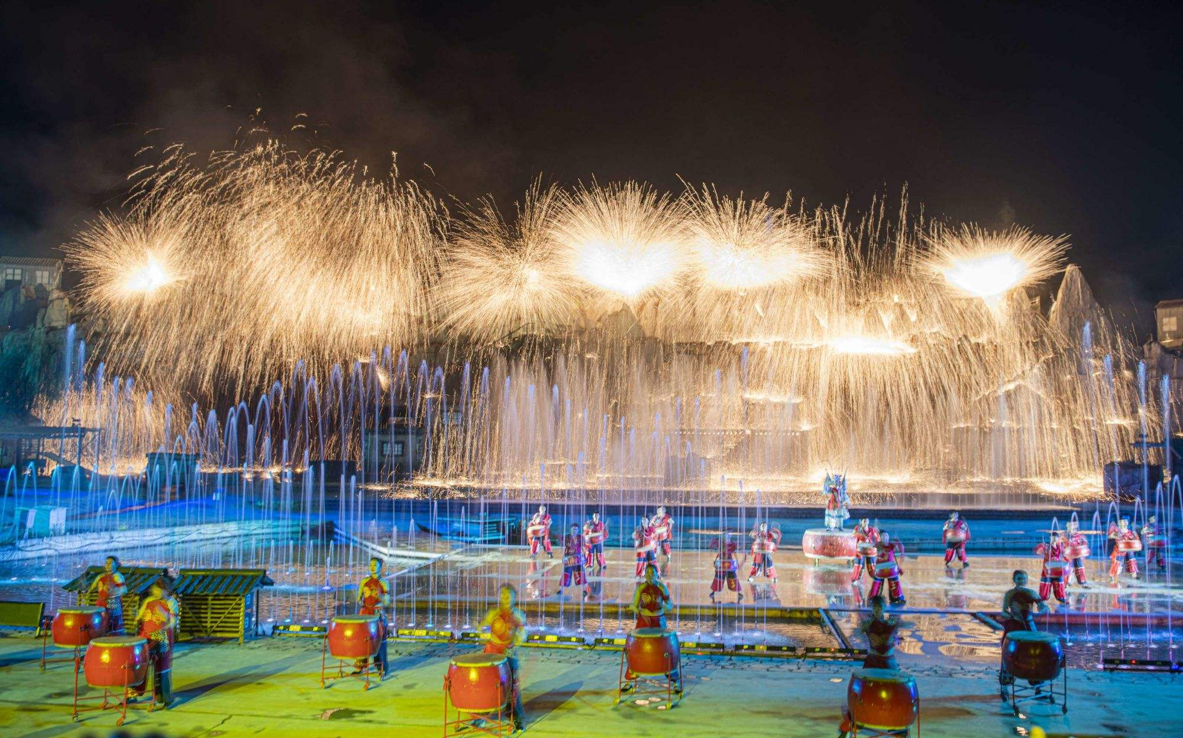
语法填空
语篇类型：说明文
主旨：介绍中国非物质文化遗产---打铁花

Slide 62
Every year during the Spring Festival, a small village east of Beijing puts on a special show. It's about - 15°℃,and a man dressed in a straw hat and sheepskin coat 56 (throw) spoon after spoon of heavy molten iron(铁水)at a massive, icy wall. The collision(碰撞)between the 1,600℃ liquid metal and the frozen brick creates a waterfall of sparks(火花) 57 (fall) over him, equally beautiful and dangerous.
This is a performance 58 requires extraordinary courage, skill and strength. Known as Da Shuhua, it has a history of 500 years in Nuanquan, a highly-developed steel town. Da Shuhua translates literally into“beating down the tree flowers,” 59 agricultural activity of hitting fruit trees to stimulate growth.
In ancient times, fireworks weren't always 60 (wide)affordable. So people in Nuanquan made use of scrap iron and developed Da Shuhua as a way 61 (celebrate) festivals. As a result,they brought firework displays 62 a whole new level.
Today, Da Shuhua has become more popular than ever,due to 63 (ban)on fireworks to reduce air pollution in some parts of China. Every year, this unique firework display attracts tons of people in spite of the freezing cold weather. 64 draws attention for its protection.Since 2021,it 65 (list) as an intangible cultural heritage of China.
throws/is throwing
falling
which/that
an
widely
to celebrate
to
bans
and
has been listed

Slide 63
重要词汇
1.translates literally into
2.stimulate growth
3.an intangible cultural heritage
照字面意义译成
刺激增长
非物质文化遗产

